Slide 1

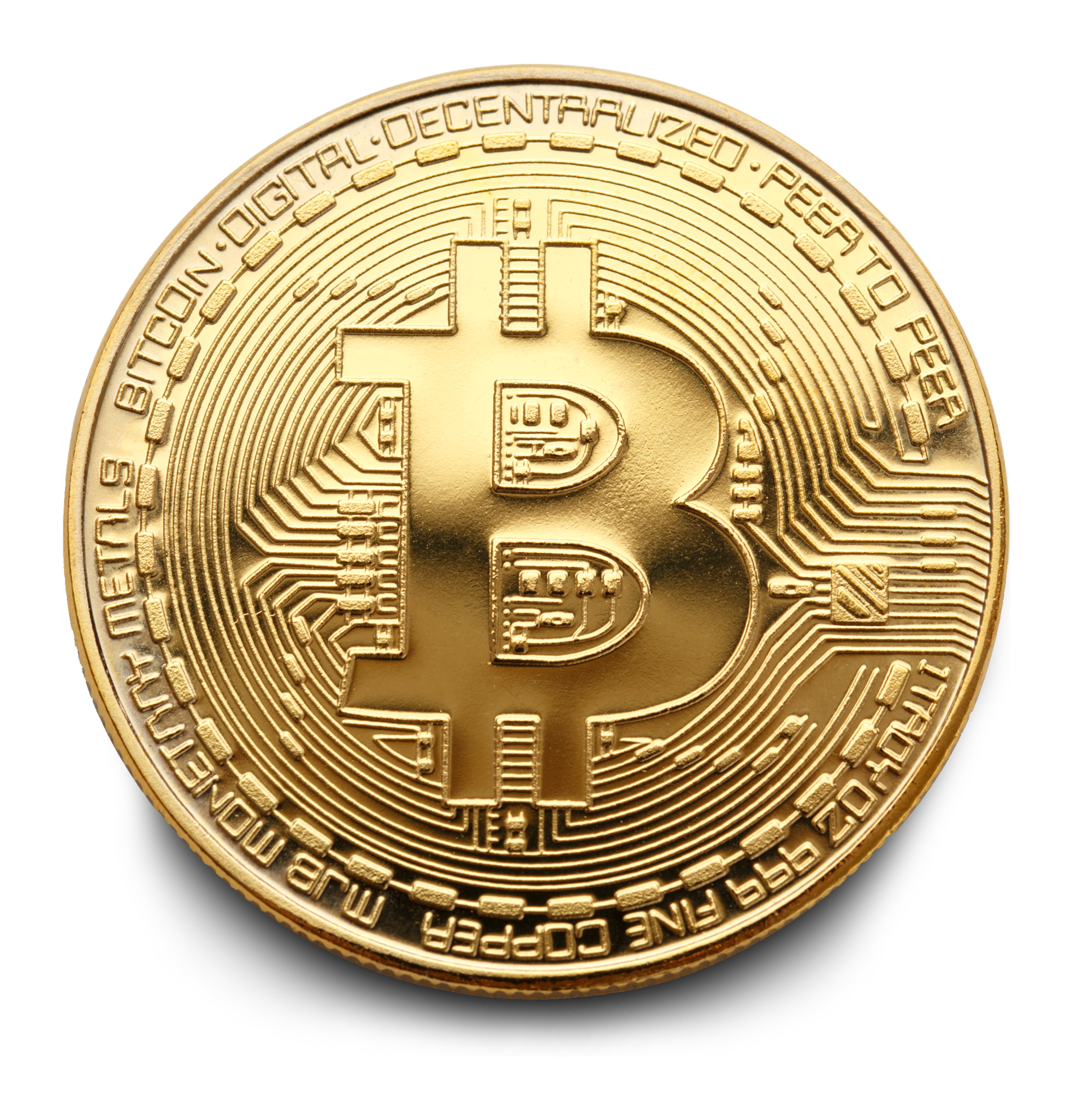

EFFECTS OF NODE TRUST INDEX ON THE NETWORK
DETERMINING THE INFLUENCE OF A NODE
% OF TRANSACTIONS BY THE FRAUDULENT OR RISKY
USERS
CENTRALITY MEASURES
TEMPORAL ANALYSIS OF THE NETWORK
APPLICATIONS &
CONCLUSION
Information & Network Flow Analysis on Bitcoin Data
BY:
ESHWAR NAG PILLI
SANJITA BHAVIRISETTY

Slide 2
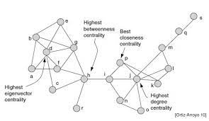
CENTRALITY MEASURES
Degree centrality
Closeness
Page Rank
Betweenness

Slide 3
Example:
2016 : closeness - fraudulent nodes:[13 35 361 481 905 1018 1396 1639 1810 2045 2067 4499] degree-fraudulent nodes : [13 35 361 905 1018 1396 1810 1953 2045 2067 3804 4499] betweeness-fraudulent nodes:[13 35 361 905 1018 1396 1810 1953 2045 2067 3804 4499] pagerank-fraudulent nodes:[35 361 481 1018 1052 1731 1810 1953 2045 2067 2124 2388 3714 3837]
Acceptability: There are approximately 12 nodes same for the centrality measures (closeness, pagerank, betweenness and degree) out of 20 top most important nodes in each year which are fraudulent.
CENTRALITY MEASURES

Slide 4
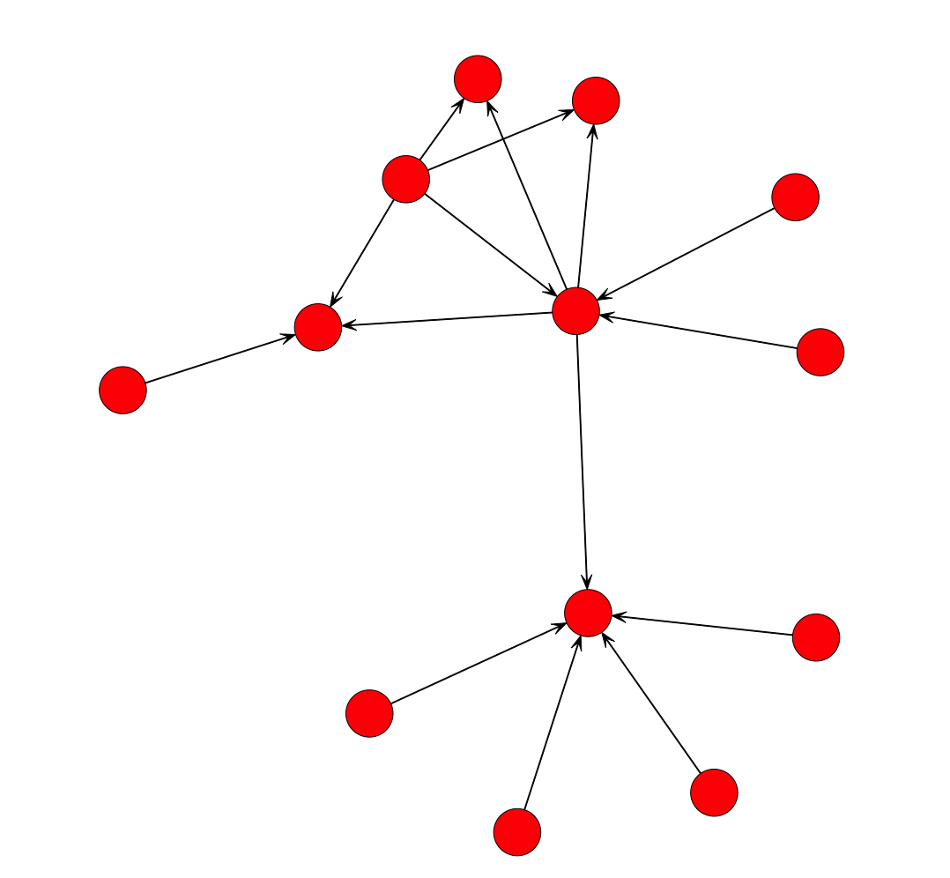
DETERMINATION OF INFLUENCE ON A NODE : Influence on Node A : 10 + 2 + 5 - 3 - 7 = 7
10
A
-3​
2
5
-7

Slide 5
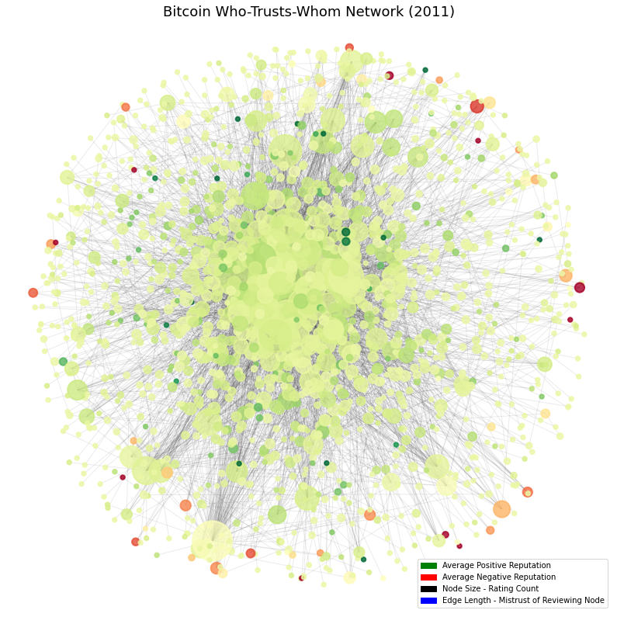
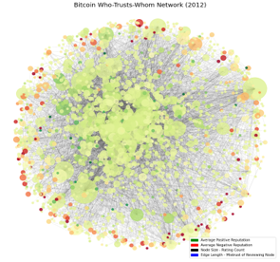
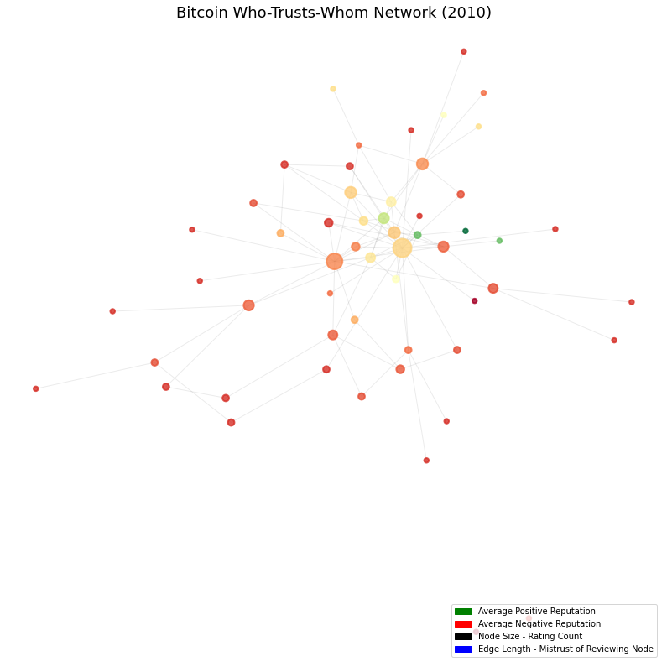
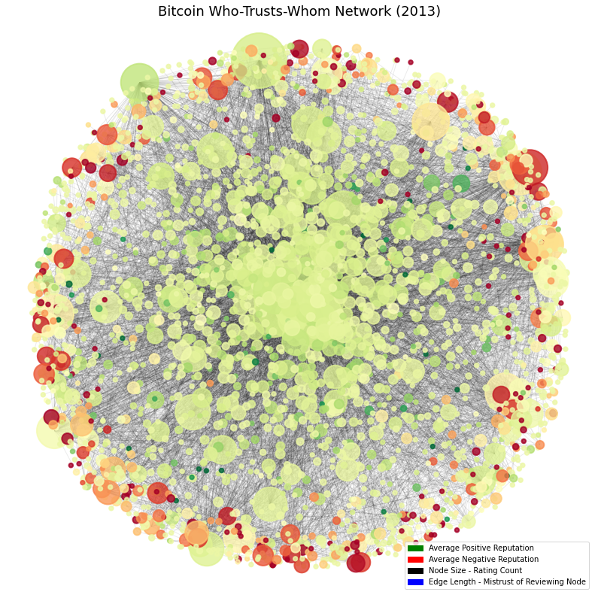
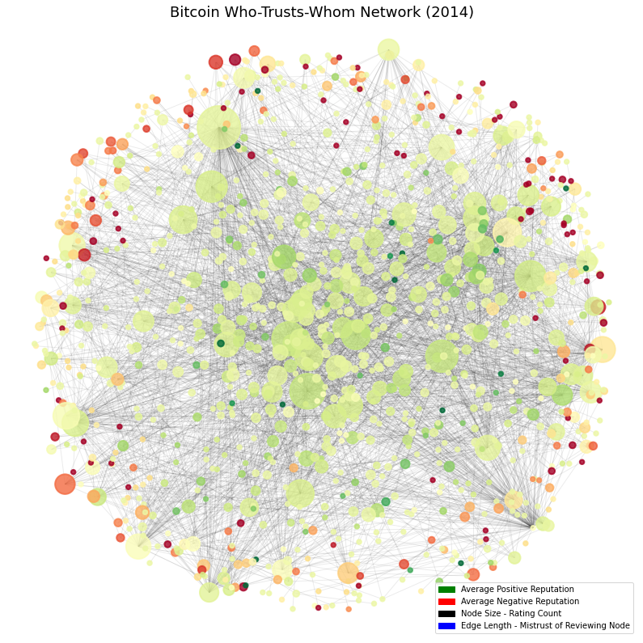
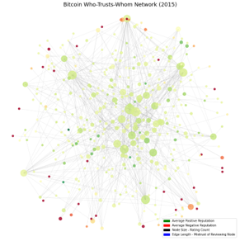
TEMPORAL ANALYSIS

Slide 6
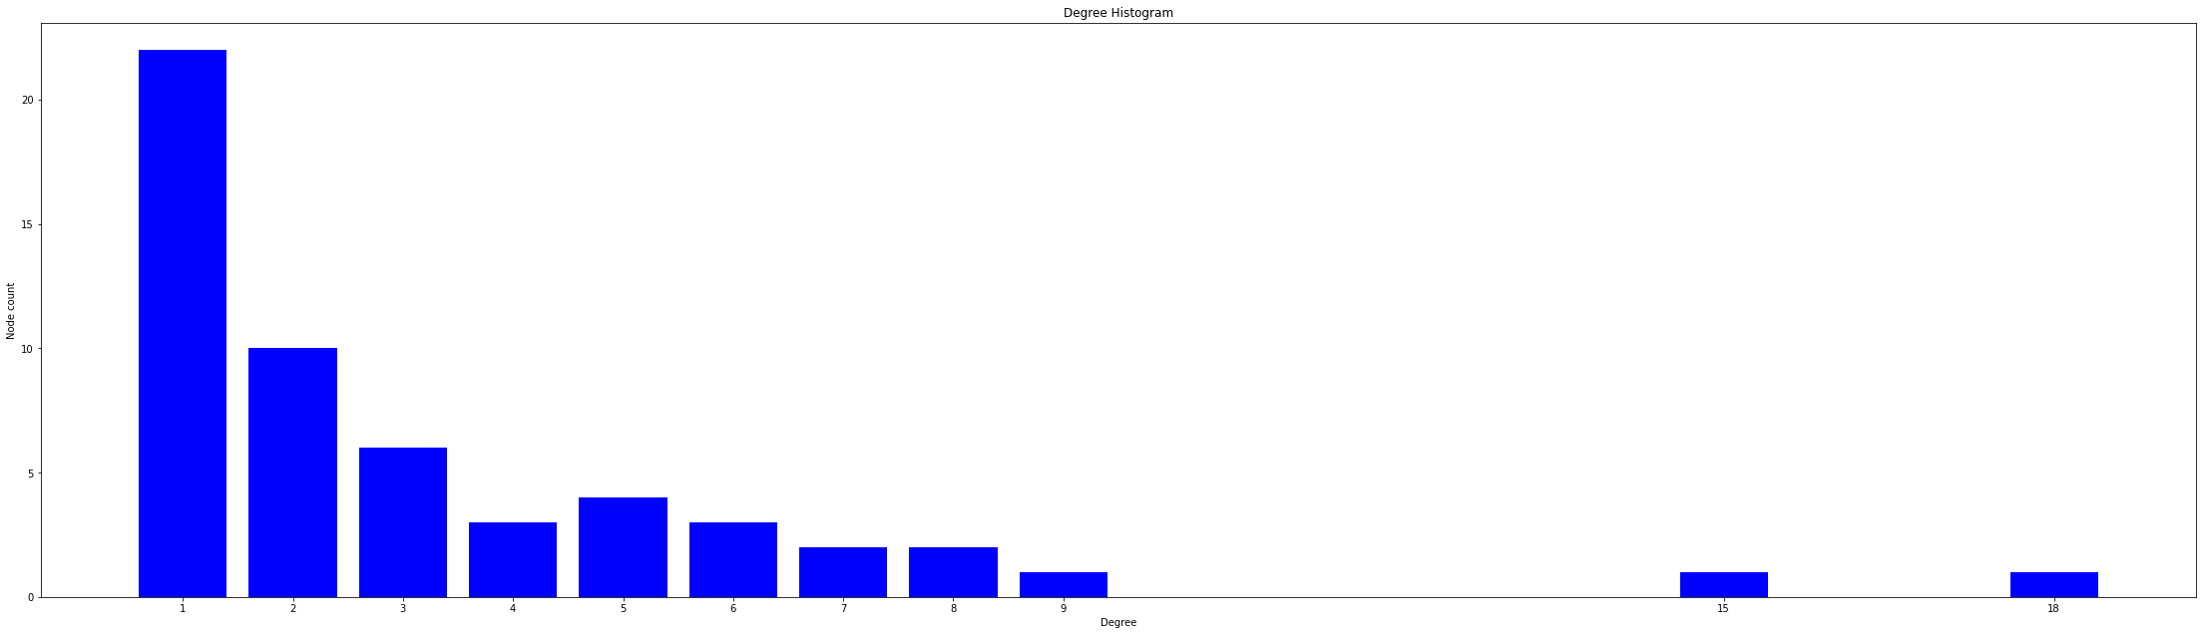
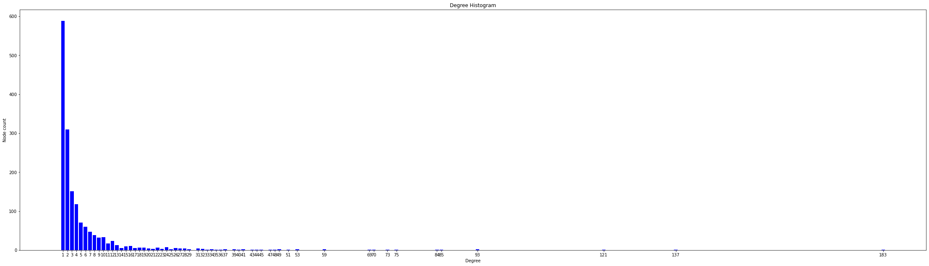
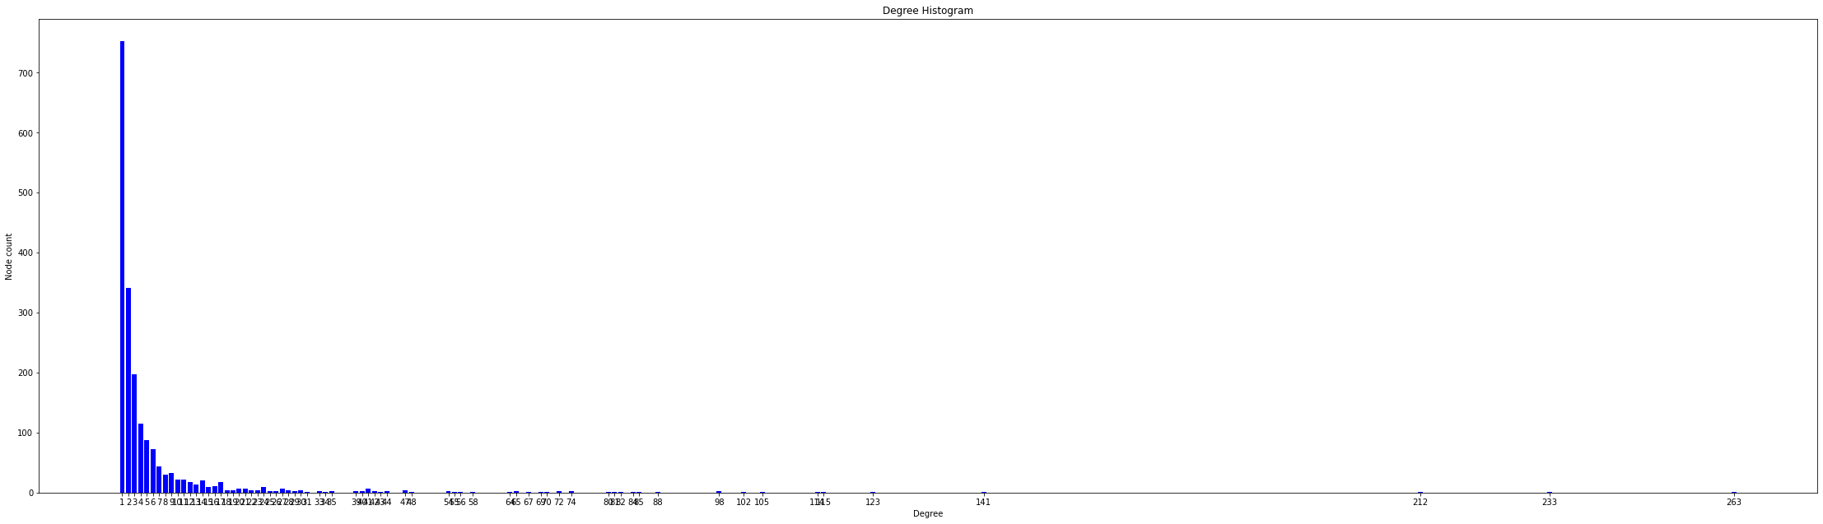
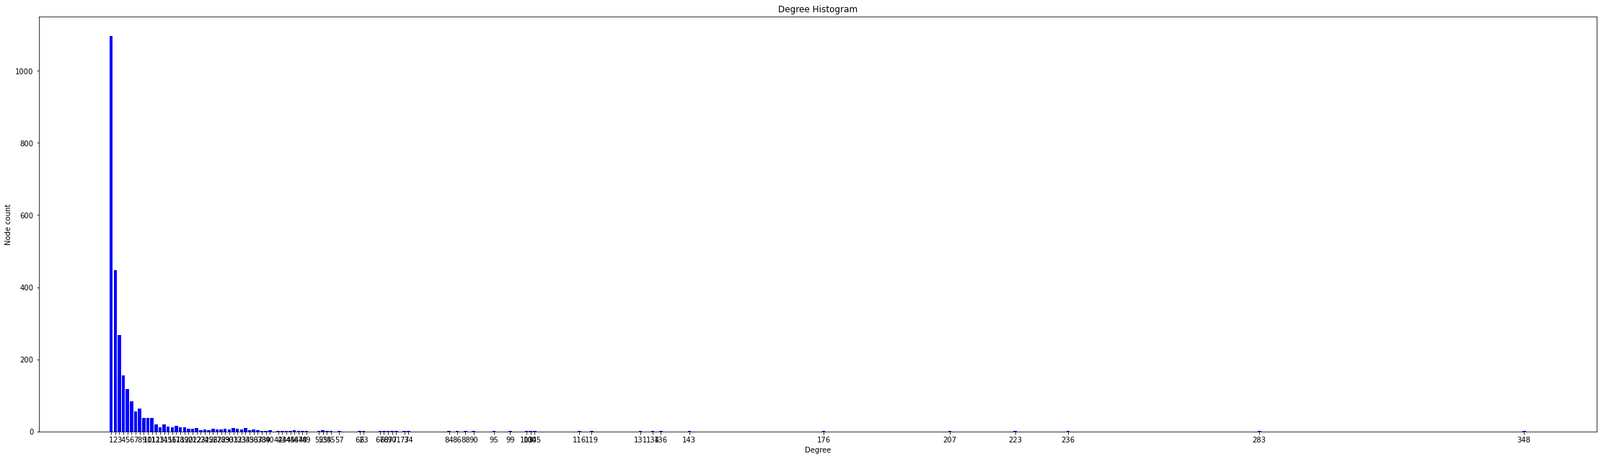
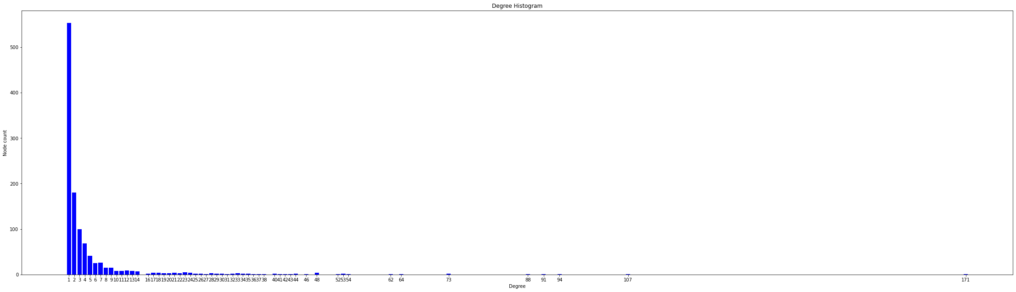
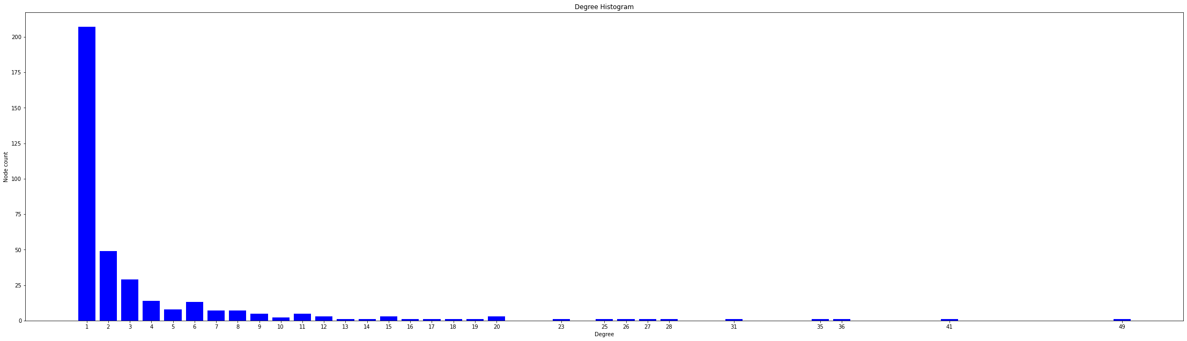
TEMPORAL ANALYSIS :
Degree distribution (degree vs node count)

Slide 7
EFFECT OF FRAUDULENT NODES ON NETWORK
All the transactions in a cluster are among the fraudulent nodes
Fraudulent node transacts with high trusted node
All +ve trust index nodes transact with each other
CASE 1
CASE 2
CASE 3

Slide 8
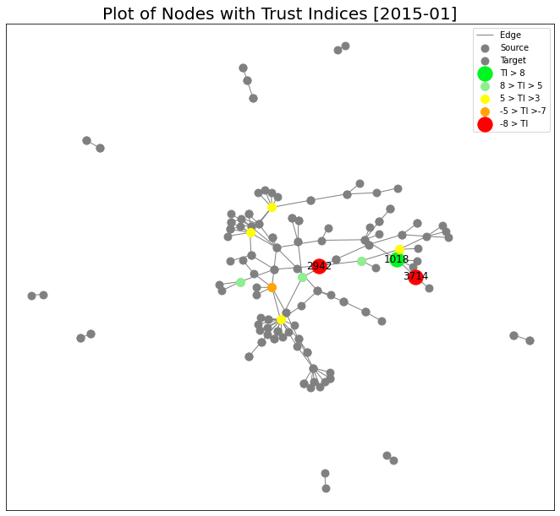

Slide 9
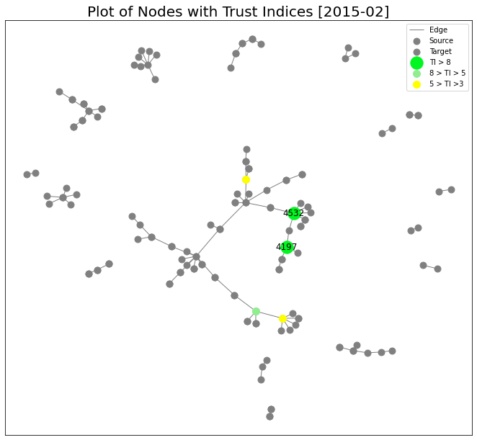

Slide 10
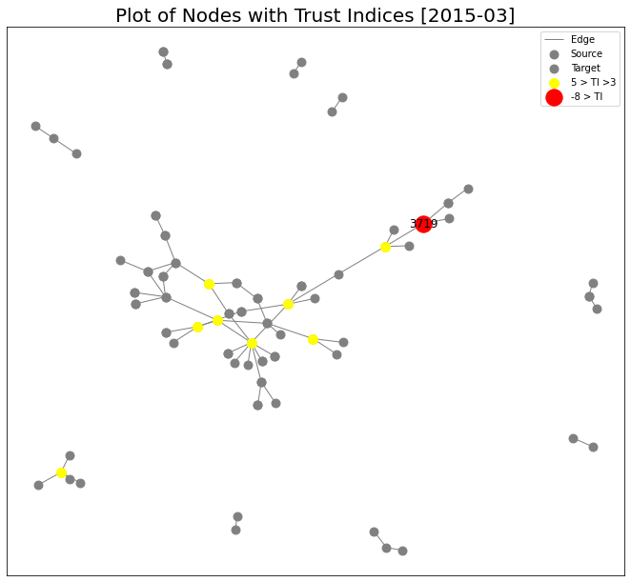

Slide 11
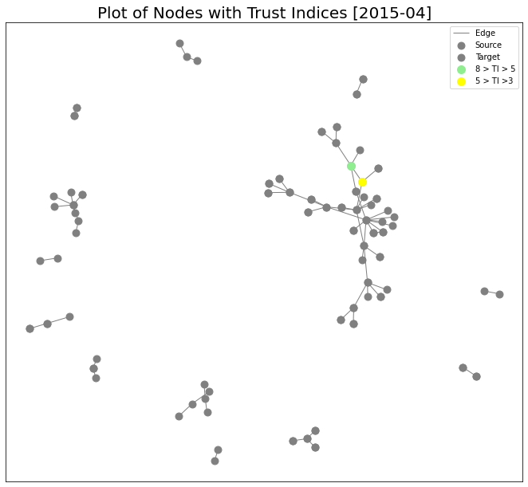

Slide 12
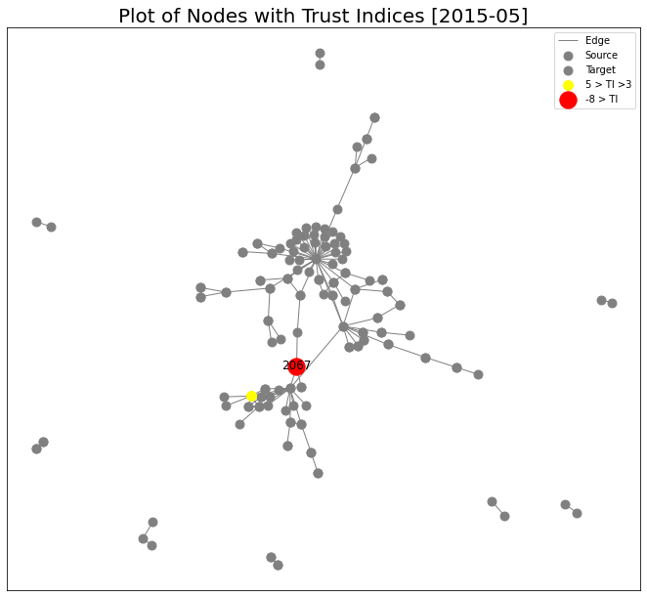

Slide 13
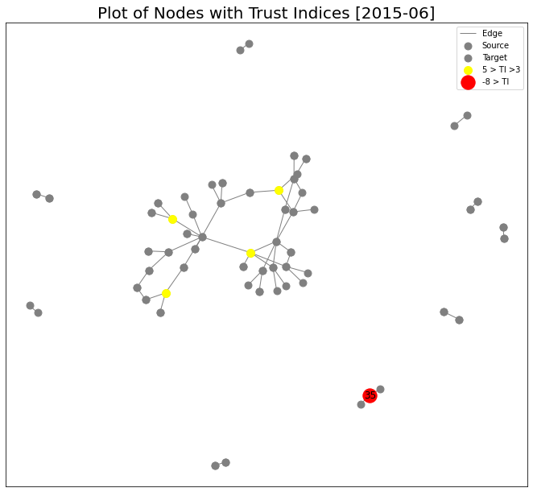

Slide 14
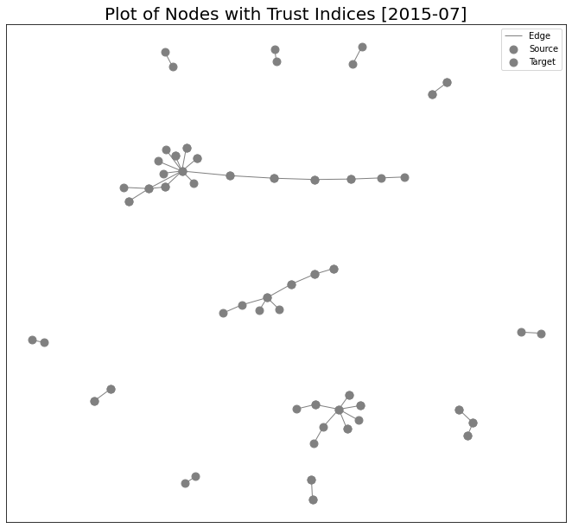

Slide 15
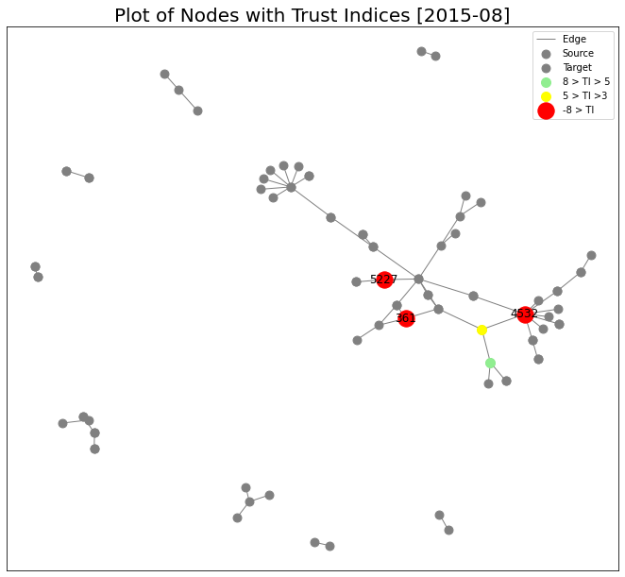

Slide 16
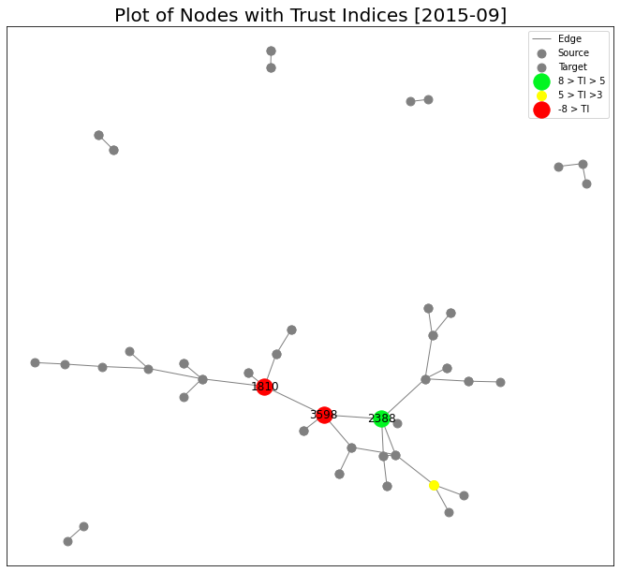

Slide 17
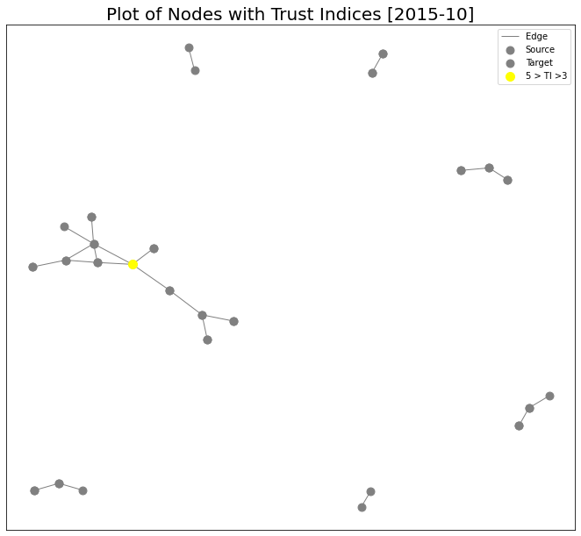

Slide 18
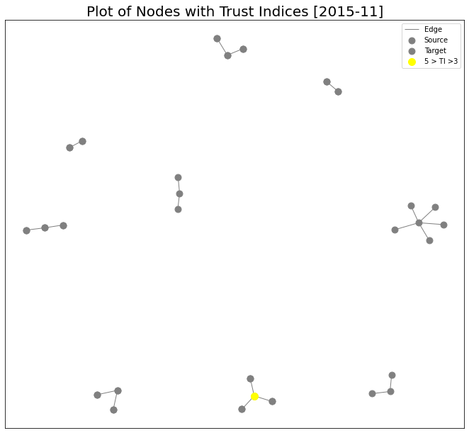

Slide 19
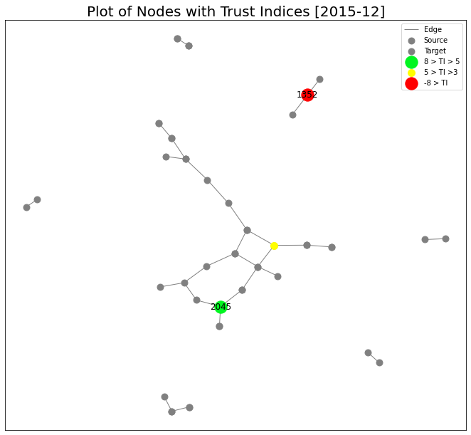

Slide 20
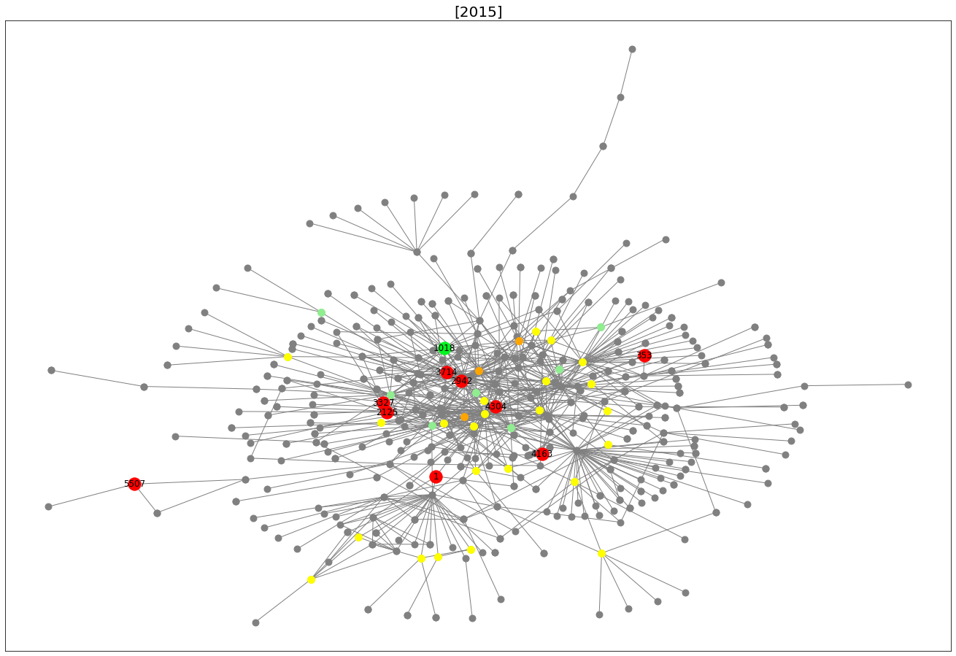
KAMADA KAWAI LAYOUT
Influential Fraudulent nodes:(PageRank) = 2125, 3714
Influential Trusted nodes:(PageRank) = 1018

Slide 21
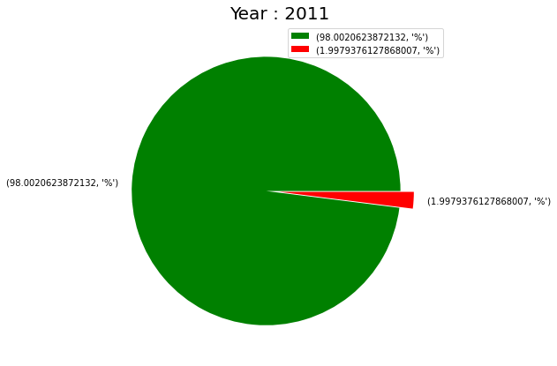
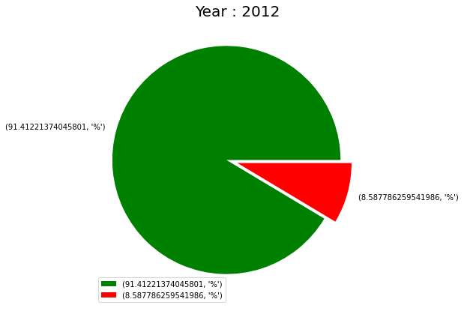
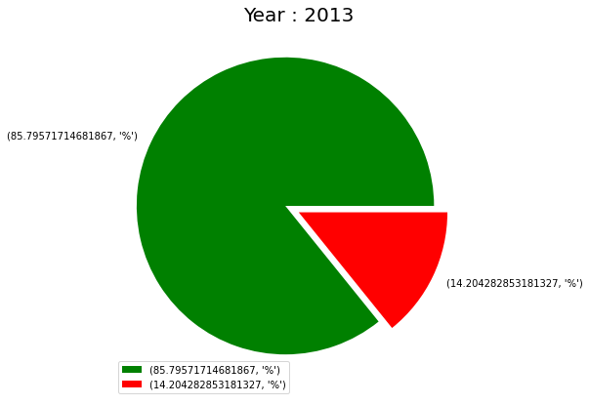
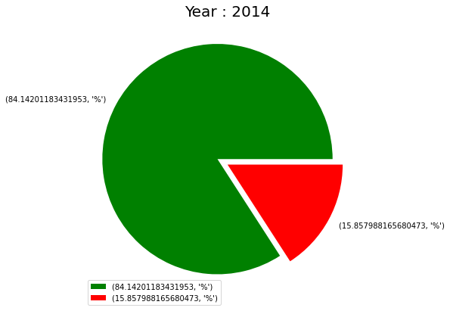
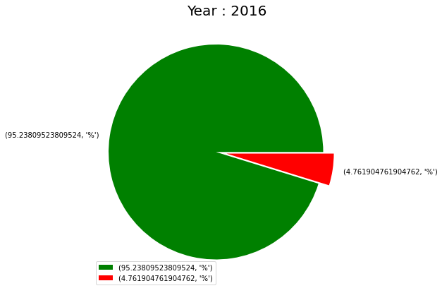
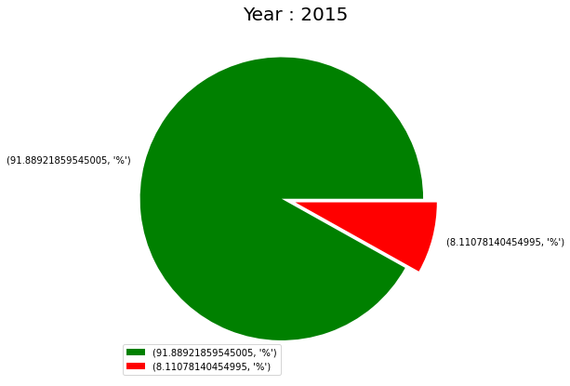
% OF TRANSACTIONS BY THE FRAUDULENT OR RISKY
USERS

Slide 22
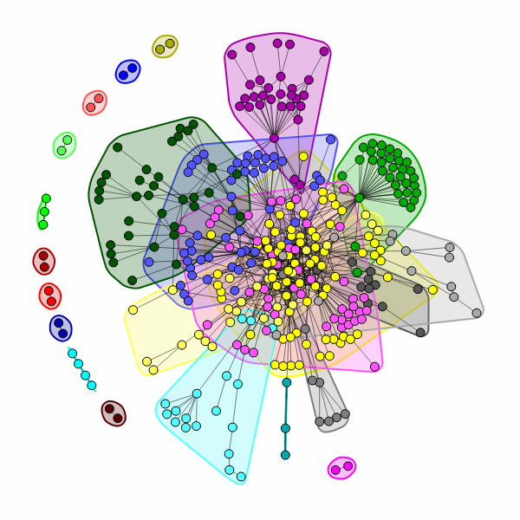
TRANSACTION CLUSTERS

Slide 23




APPLICATIONS
Fraud Call Bank Transaction
E-Commerce
Social media
Healthcare insurance claim

Slide 24
THANK YOU

